Slide 1

BBA Sem 2 Session(2023-24) Accounting Analysis
Submitted To:
Mennal Sharma
Submitted By:
Shankh Bansal

Slide 2
Analyzing Industry performance through Ratio Analysis

Slide 3
Why Tabacco Industry?
Ratio analysis can provide valuable insights into the financial performance of any company, including tobacco companies. Here are some reasons why ratio analysis can be useful for analyzing tobacco companies:
Profitability
Liquidity
Debt management
Efficiency
In summary, ratio analysis can be useful for analyzing tobacco companies because it provides information about profitability, liquidity, debt management, and efficiency. By using ratio analysis, analysts can gain a better understanding of a tobacco company's financial performance and make more informed investment decisions.

Slide 4

Types of Compamy
01
02
ITC
Golden Tabacco
03
Godfrey Phillip
Here you can describe the topic of the section
Here you can describe the topic of the section
Ratio Analysis
Here you can describe the topic of the section

Slide 5
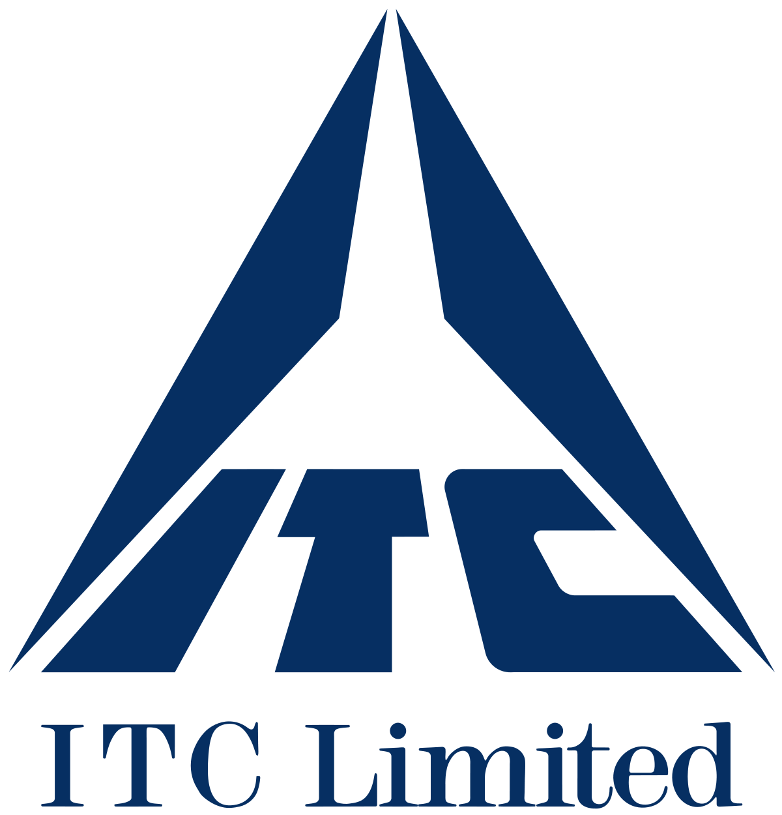
ITC
ITC Limited is an Indian conglomerate company headquartered in Kolkata. ITC has a diversified presence across industries such as FMCG, hotels, software, packaging, paperboards, specialty papers and agribusiness. The company has 13 businesses in 5 segments. It exports its products in 90 countries. Its products are available in 6 million retail outlets.

Slide 6

Golden Tabacco
Golden Tobacco Limited is an India-based company that is engaged in the business of manufacturing tobacco products and real estate. The Company's segments are Tobacco Products, Realty and Others. The Company's products include cigarettes, slim / super slim cigarettes, cigars, cigarillos and tobacco.

Slide 7

Godfrey Phillip
Godfrey Phillips India Ltd. (GPI) is a tobacco manufacturer headquartered in India. The firm was originally established in London in 1844. GPI was one of the first UK companies to mass-produce cigarettes, apart from being one of the founding companies of Imperial Tobacco along with John Player & Sons.

Slide 8

Classification Of Ratio

Slide 9
Difference between financial performance of the companies

Slide 10
Here are some general differences in the financial performance of the three tobacco companies based on their financial reports:
Revenue: In terms of revenue, ITC is the largest company of the three, with revenue of around $13 billion in 2021. Golden Tobacco and Godfrey Phillip have lower revenues, with around $300 million and $500 million respectively in the same period.
Profitability: ITC is also the most profitable company of the three, with a net profit margin of around 25% in 2021. Golden Tobacco and Godfrey Phillip have lower net profit margins, at around 5% and 10% respectively.
Liquidity: In terms of liquidity, ITC has a higher current ratio than both Golden Tobacco and Godfrey Phillip, indicating that it has more current assets relative to its current liabilities.
Debt levels: ITC has a lower debt-to-equity ratio than both Golden Tobacco and Godfrey Phillip, indicating that it has a lower level of debt relative to its equity.
Return on investment: ITC has a higher return on equity (ROE) than both Golden Tobacco and Godfrey Phillip, indicating that it generates a higher return on the investments made by its shareholders.
Overall, ITC seems to be a larger, more profitable, and more efficient company than Golden Tobacco and Godfrey Phillip. However, as mentioned earlier, a comprehensive analysis would require a more detailed review of each company's financial statements and other relevant factors.

Slide 11
Profitability Ratio
Profitability ratios are a class of financial metrics that are used to assess a business's ability to generate earnings relative to its revenue, operating costs, balance sheet assets, or shareholders' equity over time, using data from a specific point in time.

Slide 12
 | 1
 | Cash ESP
ITC | Golden Tobacco | Godfrey Phillip
13.97 | 4.61 | 110.42
12.22 | -0.36 | 95.28
14.02 | 15.87 | 103.91
11.6 | -4.15 | 64.79
10.42 | -16.4 | 49.32
If a company has a high ESP, it means that it is generating more profits for each outstanding share of its stock, which can be beneficial for shareholders.
ITC is indicating average ESP ratio which means the company is earning from its share also.
Golden Tabacco is indicating poor ESP which means the company has undervalued its fundamentals.
Godfrey Phillip is indicating excellent ESP ratio which means the company is generating excellent profit.

Slide 13
 | 2
 | Return from operations
ITC | Golden Tobacco | Godfrey Phillip
49.23 | 23.76 | 514.35
40.03 | 13.32 | 478.84
40.19 | 43.26 | 548.77
39.44 | 46.56 | 476.41
35.6 | 21.01 | 444.58
In the table, we can see that Godfrey Phillip has the highest RFO in each period, with the highest being 514.35. ITC has the second-highest RFO, 49.23, while Golden Tobacco has the lowest RFO, ranging from 23.76.
Overall, a high RFO indicates that a company is generating significant profits from its core business operations, which is generally seen as a positive sign. In this case, the table suggests that Godfrey Phillip has been generating the highest RFO over the given period, followed by ITC, and then Golden Tobacco. But the golden company is in trouble as it is not generating very good profit which can be a failing point for a company.

Slide 14
 | 3
 | Return on Capital Employed
ITC | Golden Tobacco | Godfrey Phillip
31.89 | -10.47 | 19.71
28.49 | 8.35 | 18.14
29.8 | -24.09 | 23.02
31.04 | -11.87 | 18.93
31.03 | 1.41 | 12.28
From the table, we can see that ITC has the highest ROCE in most of the periods, ranging from 28.49 to 31.89. Godfrey Phillip has the second-highest ROCE, ranging from 12.28 to 23.02, while Golden Tobacco has the lowest ROCE, ranging from -24.09 to 8.35.
A high ROCE indicates that a company is generating significant earnings from the capital invested in the business, which is generally seen as a positive sign. In this case, the table suggests that ITC has been generating the highest ROCE over the given period, followed by Godfrey Phillip, and then Golden Tobacco and the Golden Tabacco is making a poor use of its capital resources which is bad for the company.

Slide 15
 | 4
 | Net profit/share
ITC | Golden Tobacco | Godfrey Phillip
12.57 | 4.35 | 83.08
10.88 | -0.94 | 68.65
12.68 | 15.52 | 74.6
10.46 | -4.58 | 46.35
9.41 | -16.89 | 30.92
Looking at the data provided, we can see that Godfrey Phillip has the highest net profit per share among the three companies, followed by ITC and Golden Tobacco. This suggests that Godfrey Phillip is generating more profits for its shareholders than the other two companies.
On the other hand, Golden Tobacco has a negative net profit per share in one of the years, indicating that the company incurred losses during that period. This could be a cause for concern for investors, as it may indicate weak financial performance and reduced future earnings potential.

Slide 16
 | 5
 | Cash Earning Retention Ratio
ITC | Golden Tobacco | Godfrey Phillip
61.89 | 0 | 78.27
58.45 | 0 | 0
58.42 | 0 | 67.28
55.08 | 0 | 87.66
53.87 | 0 | 83.78
The CERR is an important metric for investors to consider when evaluating a company's financial health and growth prospects. A high CERR which we find in ITC & Godfrey Phillip that indicates that the company is reinvesting a significant portion of its earnings back into the business, which may lead to future growth opportunities. However, a low CERR which is seen in Golden Tabacco may suggest that the company is distributing more of its earnings to shareholders as dividends and may not have as much capital available for future investments.

Slide 17
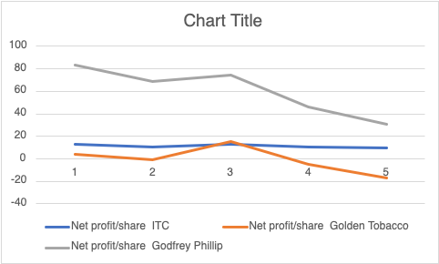
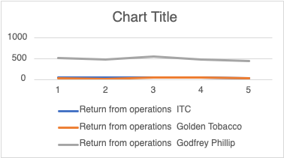
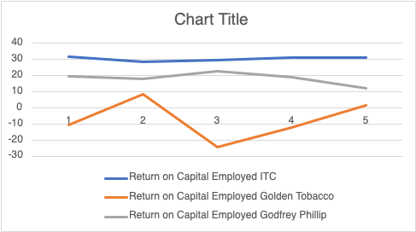
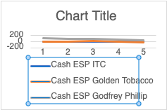
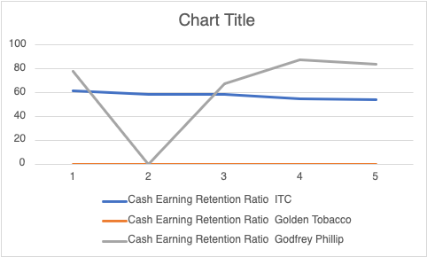
Graphs

Slide 18
Financial Ratios
A financial ratio or accounting ratio is a relative magnitude of two selected numerical values taken from an enterprise's financial statements.

Slide 19
 | 1
 | Return on Equity
ITC | Golden Tobacco | Godfrey Phillip
24.4 | -5.25 | 15.85
21.8 | 0 | 14.77
23.44 | -18.24 | 18.82
21.29 | 0 | 12.7
21.46 | 0 | 9.41
Looking at the given data, we can see that ITC has the highest ROE among the three tobacco companies, with an average ROE of 22.73%. Godfrey Phillip has an average ROE of 15.61%, and Golden Tobacco has an average negative ROE of -2.34%, which indicates that it is not generating profits for its shareholders which is a bad sign for the company.
A higher ROE generally indicates that a company is using its shareholder's funds more efficiently to generate profits. However, it's important to note that a higher ROE could also mean that a company has a high level of debt, which can magnify returns but also increase risk. Therefore, it's important to consider other financial ratios and factors before making any investment decisions.

Slide 20
 | 2
 | Return on Capital Employed
ITC | Golden Tobacco | Godfrey Phillip
31.89 | -10.47 | 19.71
28.49 | 8.35 | 18.14
29.8 | -24.09 | 23.02
31.04 | -11.87 | 18.93
31.03 | 1.41 | 12.28
Looking at the data you provided, ITC has the highest ROCE of 31.89%, followed by Godfrey Phillip with a ROCE of 19.71%, and Golden Tobacco with a negative ROCE of -10.47%. This suggests that ITC is generating the highest return on its capital employed, while Golden Tobacco is not able to generate profits that exceed its capital employed, indicating an inefficient use of capital which will create a drastic negative impact on the company.

Slide 21
 | 3
 | Return on Assets
ITC | Golden Tobacco | Godfrey Phillip
19.72 | 3.69 | 11.23
17.82 | -0.7 | 10.14
19.78 | 10.82 | 12.52
17.53 | -2.83 | 9.11
17.53 | -9.08 | 6.94
This ratio measures the return earned by a company on its total assets. A higher return on assets indicates better efficiency in generating profits with its assets. In this case, ITC and Godfrey Phillip have relatively high return on assets, while Golden Tobacco has a low ratio. This could suggest that Golden Tobacco may not be utilizing its assets efficiently to generate profits.

Slide 22
 | 4
 | Net Operation Revenue
ITC | Golden Tobacco | Godfrey Phillip
5.09 | 1.69 | 1.95
5.46 | 1.4 | 1.88
4.28 | 1.01 | 1.7
7.52 | 1.2 | 2.41
7.19 | 3.54 | 1.84
The Net Operation Revenue ratio, It is calculated by dividing a company's net operating revenue (or sales revenue) by its market capitalization.
A higher ratio which is seen in ITC indicates that a company is generating more revenue per unit of market capitalization, which can be a sign of higher efficiency and profitability. On the other hand, a lower ratio which is seen in Golden Tabacco & Godfrey Phillip suggests that a company may not be generating as much revenue for its market value and may not be as efficient in its operations.

Slide 23
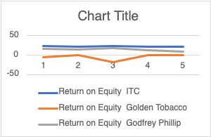
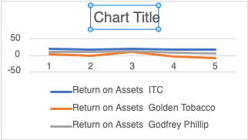
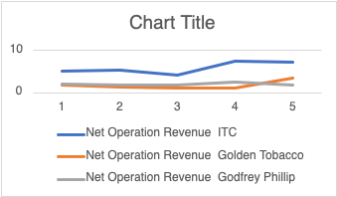
Graphs

Slide 24
Liquidity Ratio
Liquidity ratios are a measure of the ability of a company to pay off its short-term liabilities. Liquidity ratios determine how quickly a company can convert the assets and use them for meeting the dues that arise.

Slide 25
 | 1
 | Current Ratio
ITC | Golden Tobacco | Godfrey Phillip
2.82 | 0.04 | 1.89
3.27 | 0.08 | 1.81
4.13 | 0.09 | 1.32
3.17 | 0.1 | 1.36
2.85 | 0.2 | 1.57
From the table, we can see that ITC has the highest Current Ratio in each period, with the highest being 4.13. This suggests that ITC is in a relatively stronger position to meet its short-term obligations using its short-term assets. Godfrey Phillip has the second-highest Current Ratio, ranging from 1.32 to 1.89, while Golden Tobacco has the lowest Current Ratio, ranging from 0.04 to 0.2.
A high Current Ratio is generally seen as a positive sign as it indicates that a company has a strong liquidity position and is able to meet its short-term obligations. However, having a very high Current Ratio may suggest that a company is not using its short-term assets effectively, which could potentially lower its overall profitability. On the other hand, having a low Current Ratio may suggest that a company is facing challenges in meeting its short-term obligations, which could impact its financial stability.

Slide 26
 | Quick Ratio
ITC | Golden Tobacco | Godfrey Phillip
1.91 | 0.01 | 1
2.29 | 0.02 | 0.99
3.19 | 0.03 | 0.5
2.38 | 0.03 | 0.6
2.03 | 0.06 | 0.68
Based on the given information, we can see that:
ITC has a Quick Ratio of 1.91, indicating that it has sufficient quick assets to cover its current liabilities.
Golden Tobacco has a Quick Ratio of 0.01, indicating that it has very low liquidity and may have difficulty meeting its short-term obligations.
Godfrey Phillip has a Quick Ratio of 1, indicating that it has just enough quick assets to cover its current liabilities.
It is important to note that a Quick Ratio of 1 or higher is generally considered to be a good indicator of a company's short-term liquidity. However, it is also important to consider other factors such as the industry norms, the company's historical trend, and its overall financial health.

Slide 27
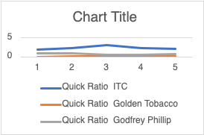
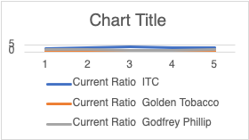
Graphs

Slide 28
Turnover Ratio
A turnover ratio in business is a measurement of the firm's efficiency. It is calculated by dividing annual income by annual liability.

Slide 29
 | 1
 | Assets Turnover Ratio
ITC | Golden Tobacco | Godfrey Phillip
0.76 | 20.18 | 0.73
66.74 | 10.05 | 0.75
63.85 | 30.17 | 92.12
67.34 | 28.88 | 93.68
67.58 | 11.3 | 99.81
From the table, we can see that Godfrey Phillip has the highest Assets Turnover Ratio in each period, ranging from 0.73 to 99.81. This suggests that Godfrey Phillip is generating a relatively high amount of revenue for every unit of assets it holds. ITC also has a high Assets Turnover Ratio, ranging from 0.76 to 67.58, while Golden Tobacco has the lowest Assets Turnover Ratio in each period, ranging from 10.05 to 30.17.
A high Assets Turnover Ratio is generally seen as a positive sign as it indicates that a company is using its assets efficiently to generate revenue. However, having a very high Assets Turnover Ratio may suggest that a company is operating at a very low margin or is relying heavily on its fixed assets. On the other hand, having a low Assets Turnover Ratio may suggest that a company is not using its assets effectively, which could lower its overall profitability.

Slide 30
 | 2
 | Inventory turnover Ratio
ITC | Golden Tobacco | Godfrey Phillip
1.57 | 3.89 | 0.85
4.69 | 0.98 | 0.8
5.51 | 2.86 | 4.65
6.09 | 2.72 | 4.35
5.73 | 0.58 | 4.52
From the table, we can see that ITC has the lowest Inventory Turnover Ratio in each period, ranging from 1.57 TO 6.09, which indicates that it ta longer to sell and replace its inventory. In contrast, ITC has a moderate Inventory Turnover Ratio, ranging from 1.57 to 5.73, while Golden Tobacco has the highest Inventory Turnover Ratio in each period, ranging from 3.89 to 6.09.
Having a high Inventory Turnover Ratio generally indicates that a company is selling its inventory more frequently, which can suggest efficient inventory management and help to reduce the risk of inventory obsolescence. However, having a very high Inventory Turnover Ratio may suggest that a company is facing supply chain issues or may be sacrificing inventory levels to achieve higher sales.
On the other hand, a low Inventory Turnover Ratio may suggest that a company is holding too much inventory or is struggling to sell its products. This can lead to increased storage costs, the risk of inventory obsolescence, and reduced liquidity.

Slide 31
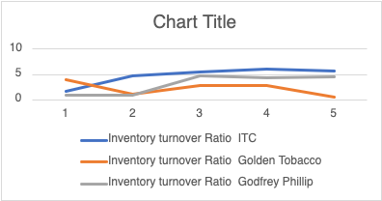
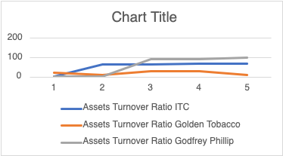
Graphs

Slide 32
Solvency Ratio
A solvency ratio is a key metric used to measure an enterprise's ability to meet its long-term debt obligations and is used often by prospective business lenders.

Slide 33
 | 1
 | Interest Coverage Ratio
ITC | Golden Tobacco | Godfrey Phillip
571.51 | 3.54 | 22.02
403.54 | -1.2 | 16.81
369.66 | 2.26 | 17.97
422.36 | 0.85 | 396.29
189.95 | 0.07 | 128.5
Looking at the data provided, we can see that ITC has a significantly higher interest coverage ratio than Golden Tobacco and Godfrey Phillip. This indicates that ITC is generating much more operating income than its interest expenses, which suggests that the company is in a better position to meet its debt obligations.
On the other hand, Golden Tobacco and Godfrey Phillip have much lower interest coverage ratios, which may indicate that they are struggling to generate enough operating income to cover their interest expenses. This could potentially make them more vulnerable to defaulting on their debt obligations if their financial performance worsens.

Slide 34
 | 2
 | Market Capitalization
ITC | Golden Tobacco | Godfrey Phillip
5.09 | 1.69 | 1.95
5.46 | 1.4 | 1.88
4.28 | 1.01 | 1.7
7.52 | 1.2 | 2.41
7.19 | 3.54 | 1.84
Market capitalization ratio is a financial metric that compares a company's market capitalization (the total value of its outstanding shares) to its annual revenue. This ratio is used to gauge the market's valuation of a company relative to its sales. A high market capitalization which is seen in ITC ratio suggests that investors have high expectations for the company's future growth and profitability. Whereas Golden Tobacco & Godfrey Phillip is having average market capitalization which shows that the company is young and risky for future profitability,.

Slide 35
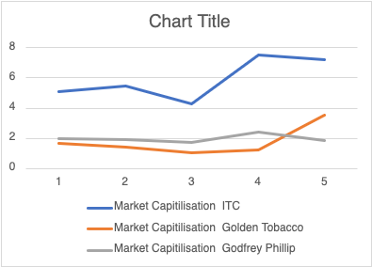
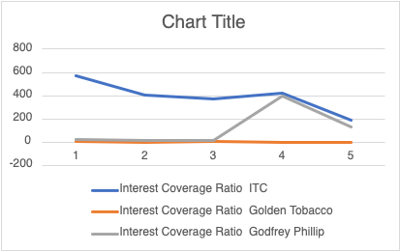
Graphs

Slide 36

Learnings from Ratio Analysis
Ratio analysis is a useful tool for analyzing a company's financial statements and determining its financial health. By examining a company's financial ratios, investors and analysts can gain insight into its performance, profitability, liquidity, solvency, and overall financial stability.
Overall, ratio analysis provides a comprehensive view of a company's financial health and helps to identify potential strengths and weaknesses. However, it is important to note that ratio analysis is not a stand-alone tool and should be used in conjunction with other financial analysis methods to make informed investment decisions.

Slide 37

THANKS!
Do you have any questions?
Shankh.bansal@avantika.edu.in
+91 6261315657

